Slide 1
Why do we model infectious diseases? Policy and practicalities
Chennai, 25/11/15

Slide 2
1. Aims

Slide 3
Aims
To introduce
Concepts of modelling for public health
Practical steps in the formulation of a model
How to include interventions within a modelling framework
Using the example of the complexity of TB natural history

Slide 4
Why do we model infectious diseases?
You?
Interesting
Understand natural history or epidemiology
Outbreak scenario
Endemic scenario
Relative impact of interventions
- What would happen if we changed current behaviour?
Predict future

Slide 5

How do we know what to model?

Slide 6

How do we know what to model?

Slide 7
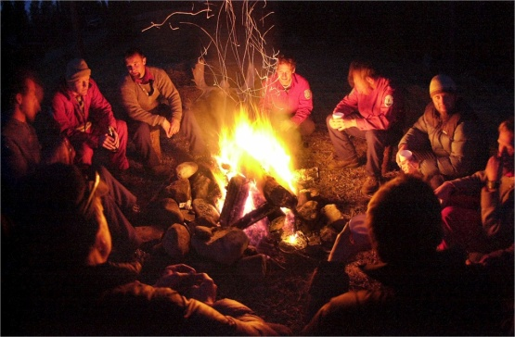
Campfire effect

Slide 8
2. Interventions

Slide 9
Modelling interventions
Why?
Policymaker needs result for trial / intervention design
Estimate population impact of intervention (over time) in different populations
Input for costing models
Understand most influential aspects of the intervention(s)
Speed of roll-out, population targeted, etc
Inform estimates of cost-effectiveness, affordability
Models need a “hook”
→ Support policy decisions, research funding, trial design, product pipeline…

Slide 10
Why is modelling good for assessing interventions?
Models are flexible
Evaluate single or combination of interventions
Evaluate alternative roll-out strategies
Extrapolate to different epidemiological situations or populations (incidence, existing diagnostic pathway)
Models capture mechanics of intervention, and can project into future
Modelling studies are (relatively) cheap and fast

Slide 11

Be aware…
Like any scientific tool, apply rigour in design, analysis and reporting
Use best
available empirical data
understanding of disease
Understanding of intervention processes
Capture and clearly present uncertainty
Similar to need for 95% confidence interval in statistical analyses
Acknowledge that uncertainty increases rapidly when projecting into future
Designing a good (intervention) model requires a lot of thought!

Slide 12
3. Impact of models

Slide 13
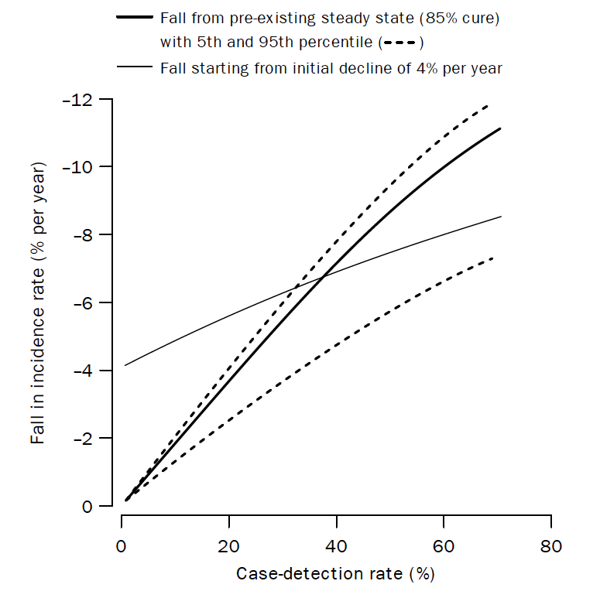
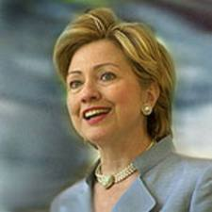
Examples of impact
TB global impact of DOTS
Dye 1998
TB vaccine targetting
Knight 2014
Ebola
Situation reports CMMID
HIV control
Granich 2009
“… We can reverse this trend. Mathematical models show that scaling up combination prevention to realistic levels in high-prevalence countries would drive down the worldwide rate of new infections by at least 40-60%….”
US Secretary of State,
Nov 8, 2011

Slide 14
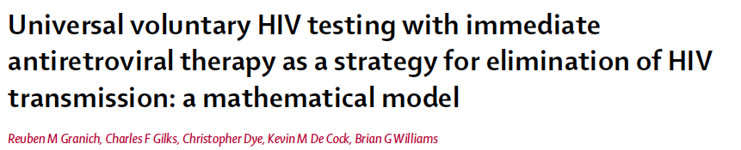
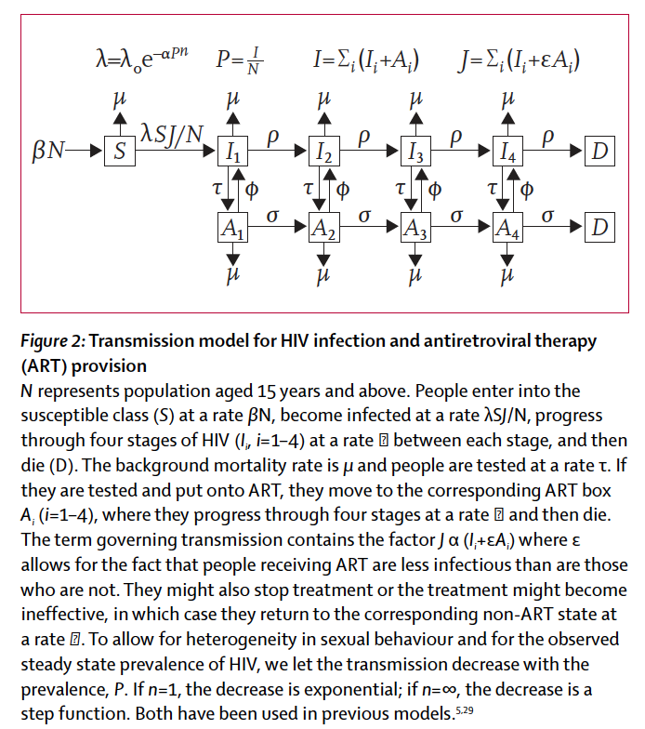
HIV control

Slide 15
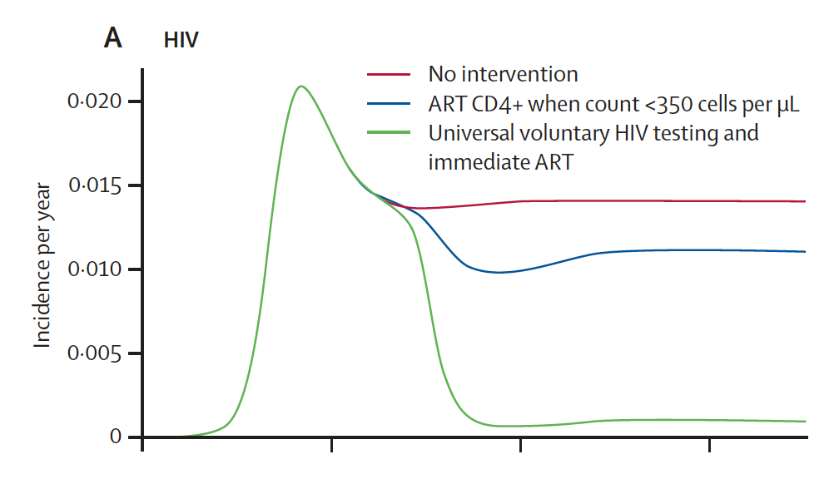
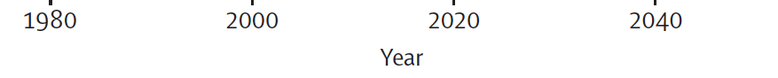
(Granich, Lancet, 2009)

Slide 16

SA & Zambia
Assumed all HIV transmission was heterosexual…
(Granich, Lancet, 2009)

Slide 17
4. Practical steps to model building

Slide 18


Practical steps to a model
Useful?
Modelling appropriate?
Relevant? for public health?
Dynamic vs. static?
Compartmental or individual?
Stochastic vs. deterministic?
Transmission vs. cohort?
Most = dynamic, compartmental, deterministic, transmission
Literature / WHO / CDC /
Country level contacts /
Expert opinon
(Vynnycky & White, 2010)

Slide 19
Practical steps to a model

Slide 20
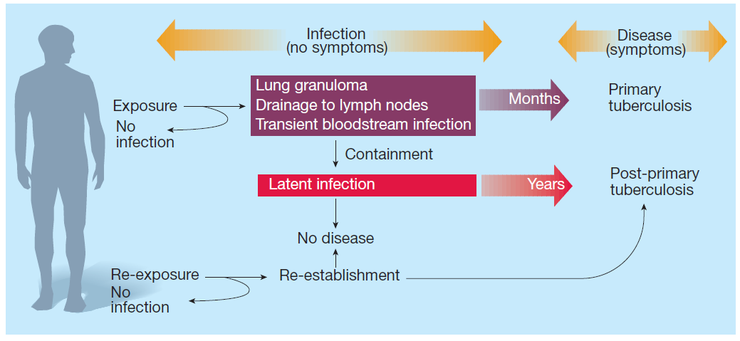
Examples
‘models should be as simple as possible and no simpler’
Einstein(?)
Ebola – new field, Seb & Anton
HIV – mixing patterns?
TB – complex natural history and transmission
(Bishai, Nature, 2000)

Slide 21
From an SIR to a TB model
disease
infection
pλ
γ
λ
S
I
R
ω + φ_{R}λ
ω
reactivation
reactivation & re-infection
(1-p)λ
η + φ_{E}λ
Slow progress to active disease & re-infection
E
Latent state
infection
w = reactivation from recovered disease
φ_{x} = protection from infection to active disease by state x
p = proportion of infections that progress immediately to infectious disease
η = slow rate to active disease activation

Slide 22
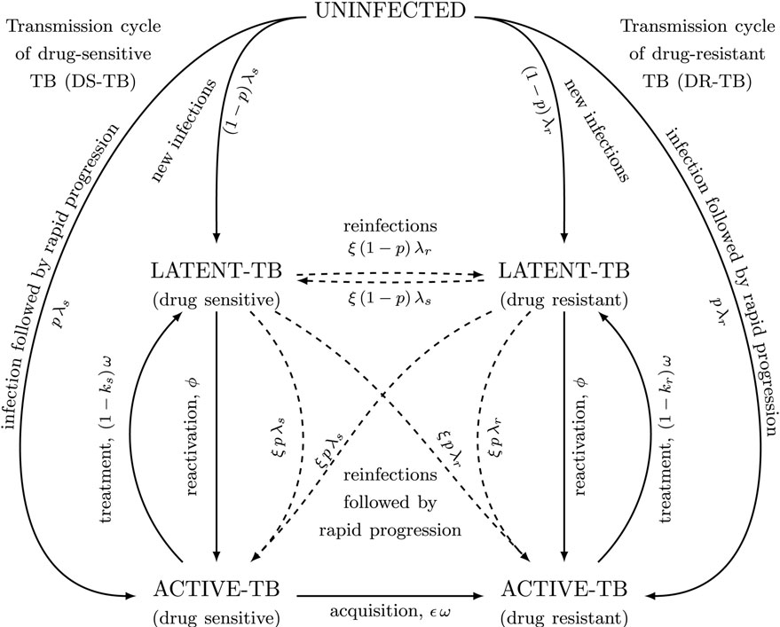
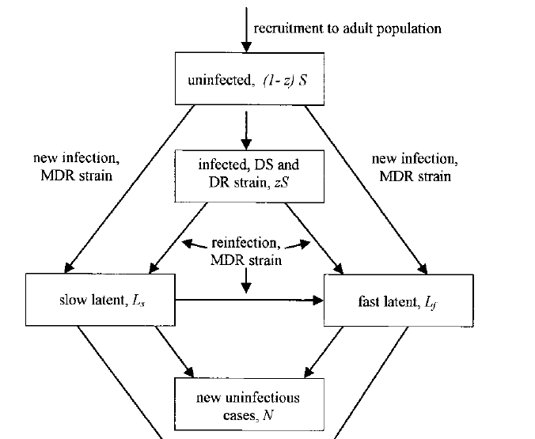
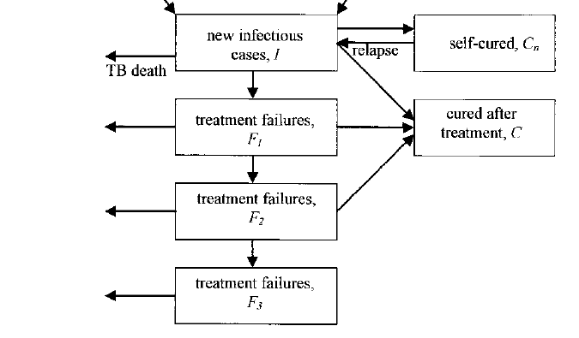
Disease vs. infection
Reinfection
Recovered vs. latent
Risk of disease by time since infection
Detection & treatment
(Lin, 2011; Dye, 2000; Shrestha, 2014)

Slide 23
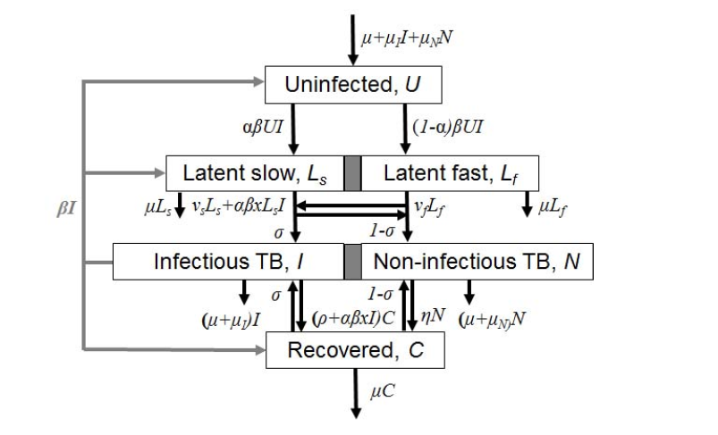
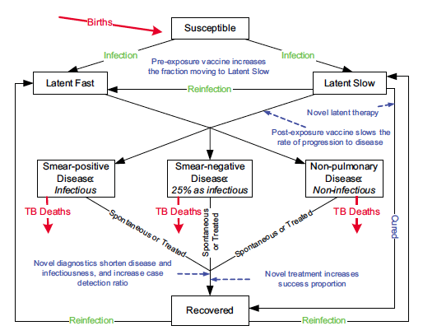
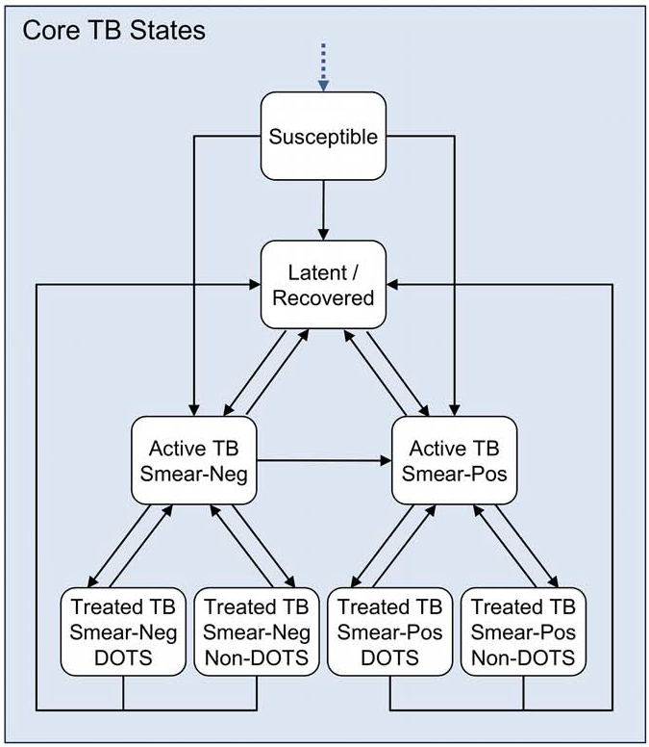
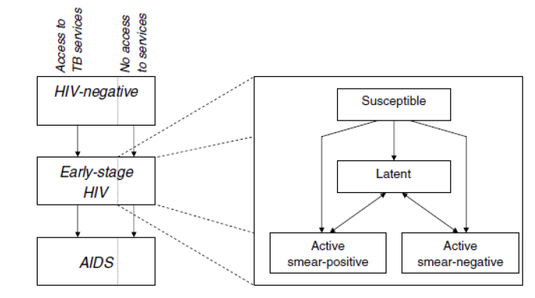
(Abu-Raddad, PNAS, 2009)
(Dye, ARPH, 2013)
(Dowdy, 2011)
(Menzies, PLoSMed, 2012)

Slide 24
Practical steps to a model
What is the question?
Lack of data
e.g.
Incidence rate
Mortality rate
Prevalence
e.g.
Effective contact rate
Disease mortality rate
Detection and treatment rate

Slide 25
Practical steps to a model
Check model outputs “expected” results
Vary parameters to maximum
Try to “break” the model
Bug checking…

Slide 26
Practical steps to a model
Linked directly to the outputs
And data availability
And question
Focus of the next few days

Slide 27
Practical steps to a model
Answer the question?
Feedback to interested parties
Explore sensitivity and uncertainty in results
Interesting part!

Slide 28
5. An example

Slide 29
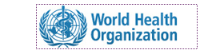
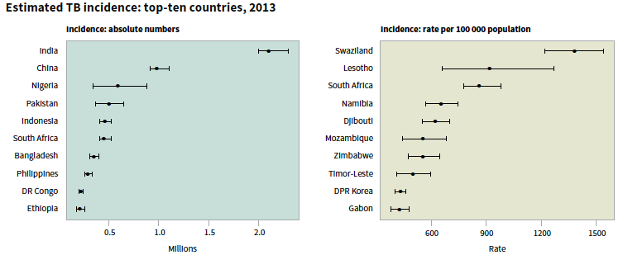
Example
TB global problem:
now causes equal number of deaths to HIV: number 1 infectious disease killer
1.5 million deaths in 2014
Big problem in India
24% of all TB cases in 2013 (2 - 2.3 million)

Slide 30
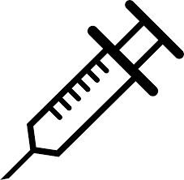
Example
Investment into TB vaccines expanding
Gates Foundation
Who should these ‘vaccines’ be given to for biggest impact?
Traditionally and easiest to give to infants
Biggest burden of disease in adolescent/adults
Cost-effective?
BCG - variable efficacy, no additional protection over background mycobacteria exposure
Assumed coverage continued at the same level

Slide 31
Practical steps to a model
QN: Who should new TB vaccines be given to?
DATA: Demographic (UN), TB (WHO), HIV (UNAIDS), vaccine coverage by country
Country selection: World Bank income group classification
94 countries included, >97% of TB burden in LIC and MIC
MODEL METHODS: Dynamic, transmission, deterministic, compartmental
Susceptible
MODEL STRUCTURE: TB/Age/HIV/Vaccine
Latently infected
MODEL INPUTS: TB natural history parameters, HIV incidence, birth/death rate, vaccine coverage
OUTPUTS: TB incidence & mortality, population size, plus number of vaccines given etc
Infectious
Non-Infectious
Recovered

Slide 32
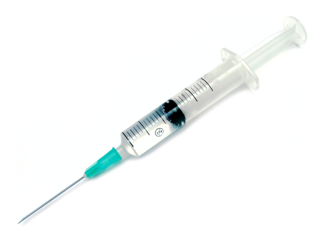



Example
Susceptible
TB vaccines
how might they work?
Where is the intervention “hook”?
Latent
Active
‘Adolescent/Adult’
‘Infant’
Age
Age
10yo
DTP3
Kim Jaeckel
Time
2024
Time
2024
2034 2044

Slide 33
Practical steps to a model

Slide 34
Practical steps to a model

Slide 35
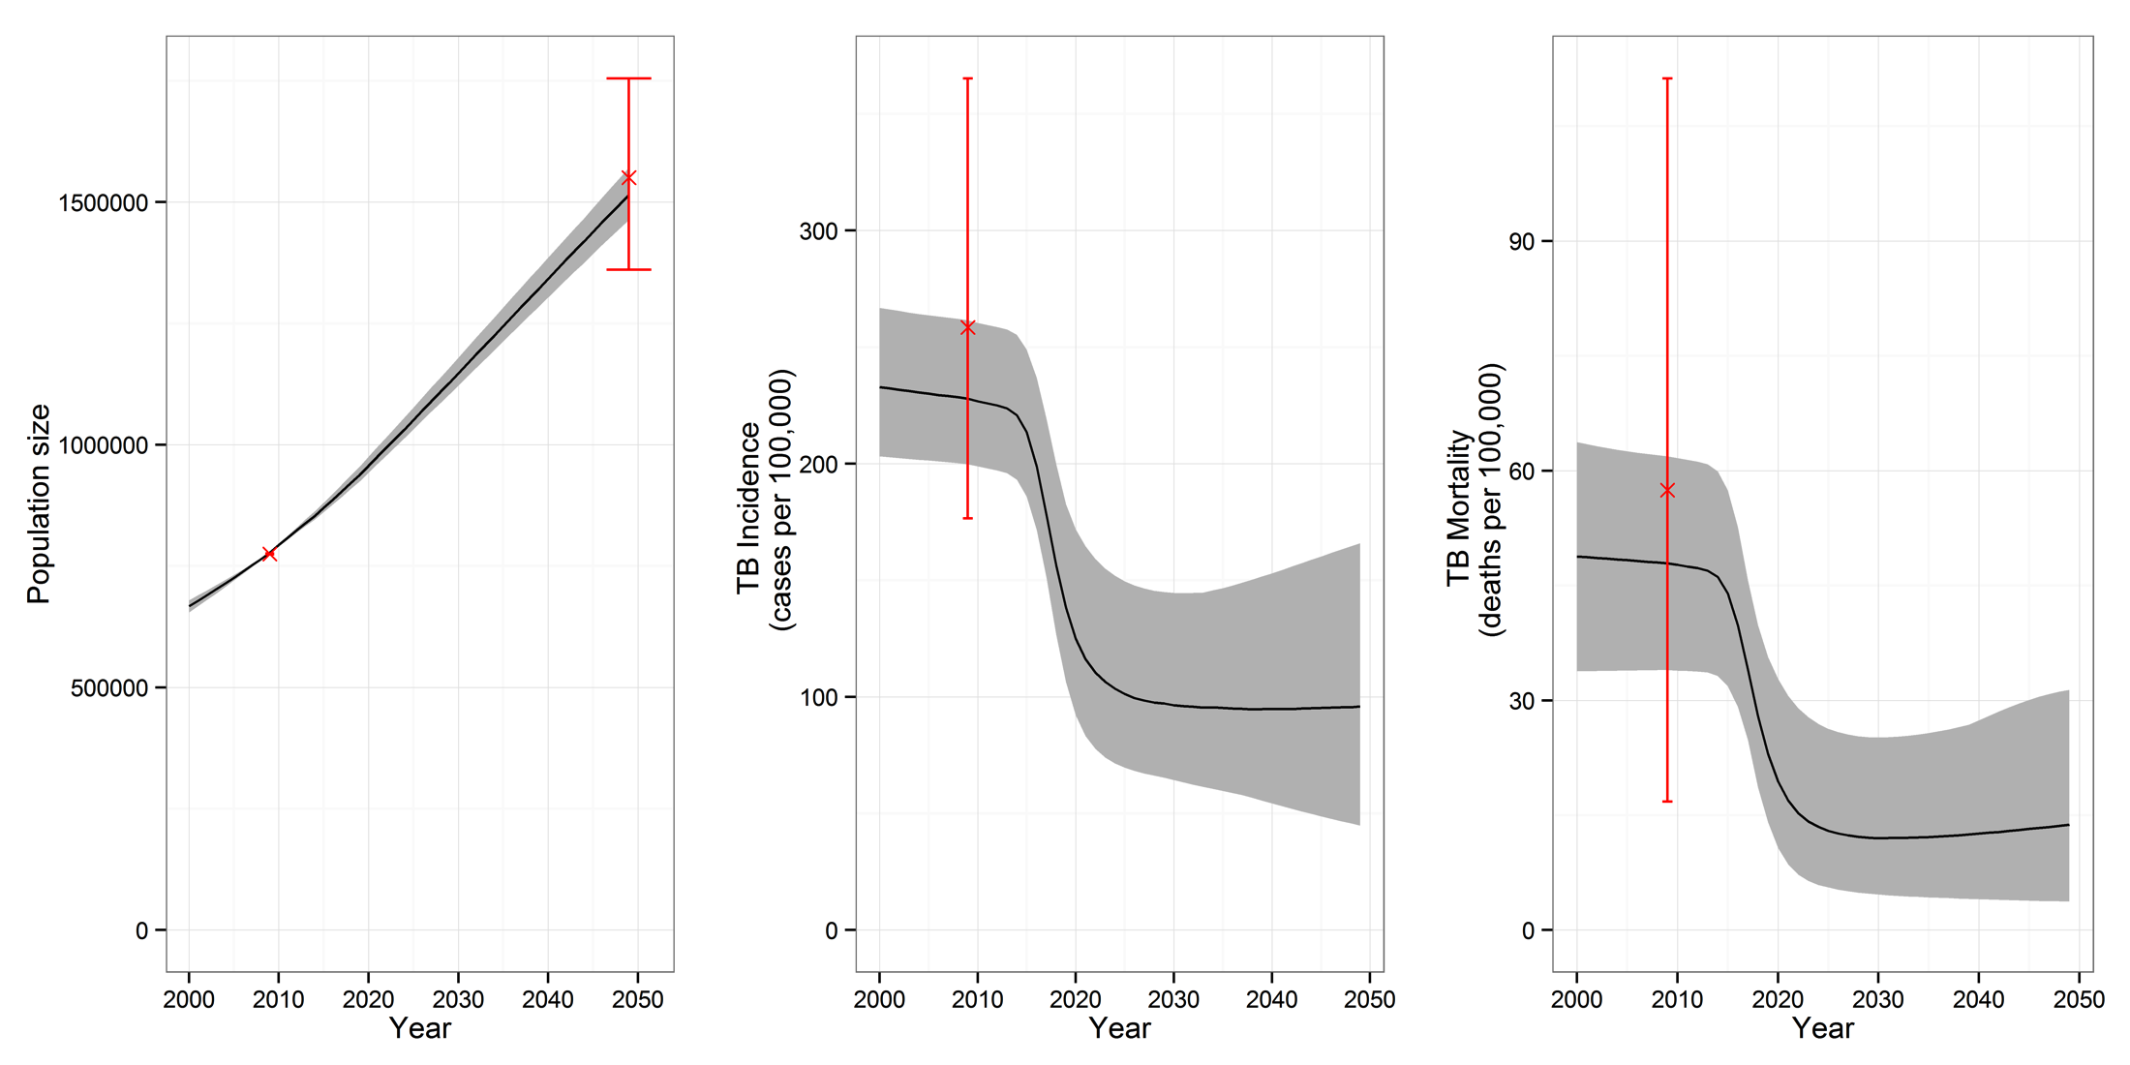
Results
Model output calibrated by country to:
Population size at 2009 and 2050
TB incidence and mortality, by HIV status, in 2009
Population size
TB disease incidence
TB mortality
LIC

Slide 36
Impact of vaccine targeted at infants
Efficacy = 40% Duration = 5 years
60% 10 years
80% Lifelong
TB disease incidence
Vaccine profile:
10yr protection,
40% efficacy
Cases averted:
0.59 (0.25 - 1.18)
million
~ 2% averted
LIC
36

Slide 37
Impact of vaccine targeted at adolescent / adults
Efficacy = 40% Duration = 5 years
60% 10 years
80% Lifelong
TB disease incidence
Vaccine profile:
10yr protection,
40% efficacy
Cases averted:
13 (8 – 18)
million
~ 40% averted
LIC
37

Slide 38
Practical steps to a model

Slide 39

Impact
Linked to cost-effectiveness work
Paper (Knight, 2014) and conference presentations
Presentations to funder (NGO/Gates)
Resulted in increased evidence base for targetting TB vaccines at adolescent / adults
Research now into how to target this population
Trials designed using adolescent / adult populations

Slide 40
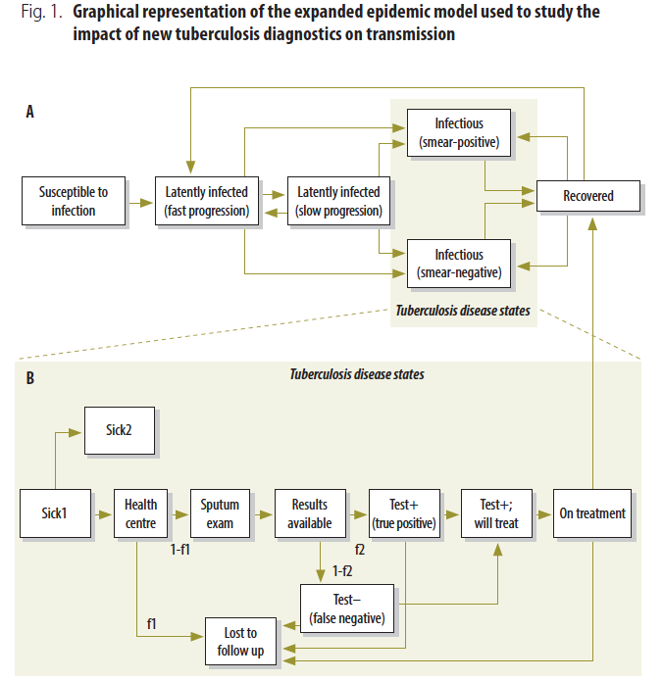
Importance of interaction with policymakers
QN: what is the impact of new diagnostics given complex contextual settings?
Basically “how does the existing system affect diagnostic impact?”
MODEL: Deterministic, expanded diagnostics pathway section (“hook” for intervention)
Used data from Tanzania
(Lin, WHO Bull, 2011)

Slide 41
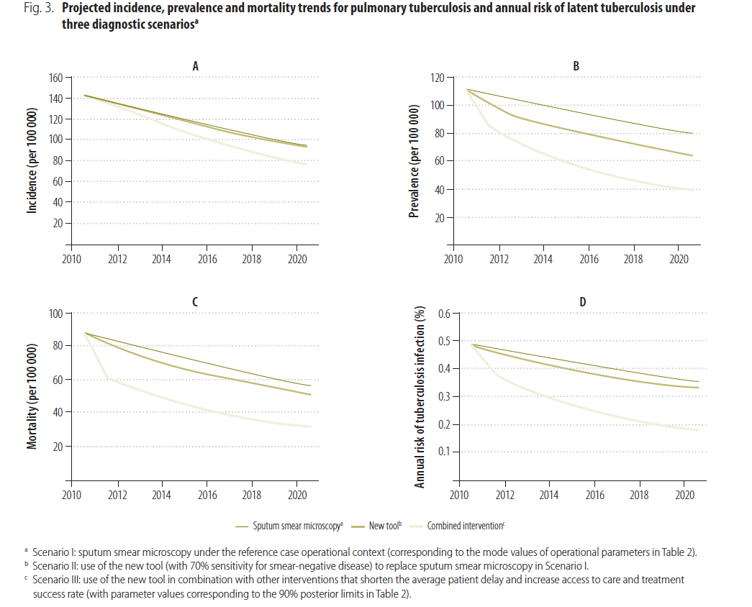
Found that adding in a new diagnostic for TB increased the decline in incidence by only 0.31 percentage points! When system already performing well…

Slide 42
Linking to policy
“New shiny tool” for TB = GeneXpert
Has been rolled out across South Africa (2013-2014) at great expense with… little to no impact on mortality or numbers started on treatment
The EXTEND study: Churchyard et al (CROI 2014). Pragmatic, randomized trial. Determined the 6 month mortality risk.
Mortality was not reduced by Xpert replacing smear: (Xpert, 3.9%) and control (smear, 5.0%); risk ratio =0.86 (p=0.42)
Xpert did increase the yield of TB by 49%, but not the proportion treated or reduce LTFU.
Therefore diagnosis is just the beginning – need system strengthening for appropriate care.
Why? Empirical therapy already highly used significantly.
Modelling could have informed this… beware the policy maker and the shiny new tool….

Slide 43
6. Summary

Slide 44
Practical model building - conclusions
Why do we model infectious diseases?
Argue that key reason is to aid decision-making process of policy makers
Models allow us to look beyond status quo, project into future, and explore a variety of scenarios and settings at low costs
But requires careful considerations of design, data and presentation of results
What are the stages in practical model building?
Gone through the detailed stages – multiple interlinking levels
Complexity of building a model for TB
How do you model an intervention?
Introduce ‘hooks’ that capture impact of intervention
Need to consider whether to introduce more model structure
Shown you a couple of detailed examples

Slide 45
Practical model building - conclusions
Why do we model infectious diseases?
Argue that key reason is to aid decision-making process of policy makers
Models allow us to look beyond status quo, project into future, and explore a variety of scenarios and settings at low costs
But requires careful considerations of design, data and presentation of results
What are the stages in practical model building?
Gone through the detailed stages – multiple interlinking levels
Complexity of building a model for TB
How do you model an intervention?
Introduce ‘hooks’ that capture impact of intervention
Need to consider whether to introduce more model structure
Shown you a couple of detailed examples

